Slide 1
WEB222 - Web Programming Principles
Week 9: More on CSS,
Page Layouts and Navigation

Slide 2
Agenda
CSS Box model
margin, border, padding, shorthand
Table formatting with CSS
Centering and positioning
CSS3 shadow effects and rounded corners
HTML 5 structural elements
Page layouts
Navigation/menus
Image gallery example

Slide 3
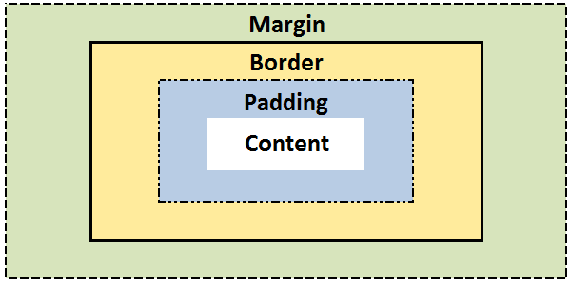
The CSS Box model
All elements can be considered to be box.
The box model is the specification that defines how a box and its attributes relate to each other.
A box is made up of four distinct parts, from the outside one to the inside one:
margin, border, padding, and content.

Slide 4
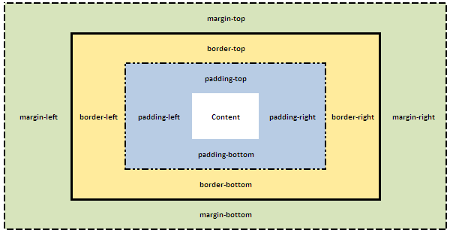
The CSS Box model
box-model.html
Notes:
Css for html and body as selectors.
-> use body for page

Slide 5
CSS Properties for Box Model
CSS margin
CSS border
border-width
border-style (required)
border-color
CSS padding
Using shorthand

Slide 6
The CSS Box Model – margin
CSS Margin property defines the white space around an HTML element's border. See the "Box model".
box-margin.html
margin | Applies to all sides
margin: 6px; /* this is a shortcut */ | Applies a margin to all sides of an element
margin-top | Applies a margin to the top of an element
margin-right | Applies a margin to the right of an element
margin-bottom | Applies a margin to the bottom of an element
margin-left | Applies a margin to the left of an element
Notes:
{Margin: auto;} can be used to centerlize the box.
To centerlize text such heading, use {text-align: center;}

Slide 7
CSS Shorthand for Box Model
CSS Shortcuts allow for a property to have a single or multiple values.
Shortcuts/shorthand order: CLOCKWISE:
top -> right-> bottom→ left

Slide 8
The margin Shorthand Property
To set all the margin properties in one declaration:
margin:10px 5px 15px 20px;
top margin is 10px
right margin is 5px
bottom margin is 15px
left margin is 20px
margin:10px 5px 15px;
top margin is 10px
right and left margins are 5px
bottom margin is 15px
margin:10px 5px;
top and bottom margins are 10px
right and left margins are 5px
margin:10px;
all four margins are 10px

Slide 9

Margin Collapsing
Top and bottom margins of blocks are sometimes combined (collapsed) into a single margin whose size is the largest of the margins combined into it, a behavior known as margin collapsing.
e.g.
h1 { margin: 0 0 25px 0; background: #cfc; }
p { margin: 20px 0 0 0; background: #cf9; }
http://www.sitepoint.com/web-foundations/collapsing-margins/

Slide 10
The CSS Box Model – border
The border property allows for setting the width, style and color and of the borders around an element.
The border style property value for the border must be stated, otherwise no border will show up.

Slide 11
The border-width Property
The border-width can be set in pixels, ems, or one of the three pre-defined values: thin, medium, or thick.
border-width.html
border-width | Applies to all sides
border-width: 6px; border-style: solid; | Applies a solid border to all sides
border-top-width | Applies only to the top border
border-right-width | Applies only to the right border
border-bottom-width | Applies only to all bottom border
border-left-width | Applies only to the left border

Slide 12
The border-width Shorthand
border-short.html
Example | Description
border-width:6px; | adds a border - 6px to all four sides
border-width:6px 12px; | adds a border - 6px to top and bottom - 12px to the right and left
border-width:6px 12px 10px; | adds a border - 6px to the top, 12px to the right, 10px to bottom and 12px to the left
border:6px solid red; | Width, style, color!

Slide 13
The border-style property
border-style | Applies to
border-style: solid; /* default width of 3px */ | Applies a solid border to all sides
border-top-style | Applies the style only to the top border
border-right-style | Applies the style only to the right border
border-bottom-style | Applies the style only to all bottom border
border-left-style | Applies the style only to the left border
The property can have a value from the list:
dotted, dashed, solid, double, groove, ridge, inset, outset, hidden.
border-style.html

Slide 14
The border-color property
border-color.html
border-color | Applies to
border-color:#ff0000; border-style: solid; | Applies a solid border to all sides
border-top-color | Applies only to the top border
border-right-color | Applies only to the right border
border-bottom-color | Applies only to all bottom border
border-left-color | Applies only to the left border

Slide 15
The Border Shorthand Property
The border property is a shorthand for the following individual border properties:
border-width
border-style (required)
border-color
Example:
p.type4 { border:6px inset #ff0000; }
border-short.html

Slide 16
The CSS Box Model – padding
CSS Padding property defines the white space around the inside of an HTML element's border. See the "Box model".
box-padding.html
padding | Applies to all sides
padding:6px; /* this a shortcut */ | Applies padding to all sides of an element
padding-top | Applies padding to the top of an element
padding-right | Applies padding to the right of an element
padding-bottom | Applies padding to the bottom of an element
padding-left | Applies padding to the left of an element

Slide 17
Table Formatting with CSS
HTML Tables are the most complex elements in HTML. A table may contain a caption, row, cell, row groups, and column groups.
Some CSS properties for table formatting:
margin, padding, width, height, text-align, vertical-align, background-color, background-image, border

Slide 18
Table Formatting with CSS
Formatting table examples:
table { margin: auto; width: 80%; }
#table2 { border: 1px solid black;
background-color: yellow; }
Formatting table cell and table header examples:
td, th { border: 4px inset #4400FF;
padding:10px 20px;
background-color: green;
height: 100px; width: 400px; }
td { text-align: left; vertical-align: bottom; }
css_table.html

Slide 19
Border Collapse
19
Property: border-collapse sets whether the table borders are collapsed into a single border or separated.
E.g.:
table { border-collapse: collapse; /* default: separate */ }
table, th, td { border: 1px solid black; }

Slide 20
Table Sections/Groups
<thead> - group the first one or more rows of a table for formatting
<tbody> - group the middle rows of a table for formatting
<tfoot> - group the last one or more rows of a table for formatting
css_table_section.html

Slide 21
CSS – display Property
The display CSS property specifies the type of rendering box used for an element.
default value: inline
the value none lets you turn off the display of an element.
e.g.
p.inline { display: none; }
css_display.html

Slide 22
The display Property Values
Value | Description
inline | Default value. Displays an element as an inline element (like <span>)
block | Displays an element as a block element (like <p>)
inline-block | Displays an element as an inline-level block container. The inside of this block is formatted as block-level box, and the element itself is formatted as an inline-level box
inline-table | The element is displayed as an inline-level table
list-item | Let the element behave like a <li> element
table | Let the element behave like a <table> element
table-caption | Let the element behave like a <caption> element
table-column-group | Let the element behave like a <colgroup> element
table-header-group | Let the element behave like a <thead> element
table-footer-group | Let the element behave like a <tfoot> element
table-row-group | Let the element behave like a <tbody> element
table-cell | Let the element behave like a <td> element
table-column | Let the element behave like a <col> element
table-row | Let the element behave like a <tr> element
none | The element will not be displayed at all (has no effect on layout)

Slide 23
Centering Lines Of Text
Centering lines of text in a paragraph or in a heading.
Examples:
p { text-align: center }
h2 { text-align: center }
Note: never use the <center> tags, which is obsolete to center text.
center_text.html

Slide 24
Centering a Block (horizontally)
Rephrase: making left and right margin to be equal.
set the margin-left and margin-right to 'auto'.
used with a block with a fixed width.
div.center {
width: 400px;
border: 2px solid red;
margin: 0 auto;
/* margin-left: auto; margin-right: auto; */
}
<div class ="center"> … </div>
center_block.html

Slide 25
Centering – Vertically
Specify the outer block as a table cell, the contents of a table cell can be centered vertically.
div { height: 100px; width: 500px; }
div.center { border: 10px dotted red;
display: table-cell;
vertical-align: middle;
text-align: center;
}
<div class="center"> This div is centered </div>
center_vertical.html

Slide 26
Positioning
CSS position property
can be used to position elements precisely in HTML pages.
a browser renders html statements in the order that they are in the html file - this is called normal flow

Slide 27
Positioning
Use the position property. Values:
static - position using normal flow (default)
absolute - position precisely within the containing element
relative - position precisely relative to normal flow
fixed - position precisely within the browser window, and does not move when the page is scrolled
Use "left“ or "right" with "top" or "bottom" properties. Their values: numeric offsets in px or %.
Example:
div#texbox { position:absolute; left:150px; top:150px; }
position.html
position2.html

Slide 28
Positioning
What if the text takes more than the allotted space?
use the property "overflow" to specify an action:
{ overflow:scroll; } - include scroll bars
{ overflow:auto; } - scroll if required
{ overflow:hidden; } - hide overflow
{ overflow:visible; } – default
position.html

Slide 29
Positioning
graphics and titles can be positioned in a similar fashion:
position_graphic.html

Slide 30
CSS3 Rounded Corners
Property: border-radius
Example:
div { border: 2px solid #a1a1a1;
padding: 10px 40px;
background: grey;
width: 300px;
border-radius: 50px;
/* border-radius:10%; */
-moz-border-radius:25px; /* Firefox 3.6 and earlier */
}
boxShadow_roundedCorners.html

Slide 31
CSS3 Rounded Corners
border-radius:2em; is equivalent to: border-top-left-radius: 2em; border-top-right-radius: 2em; border-bottom-right-radius: 2em; border-bottom-left-radius:2 em;

Slide 32
CSS3 Box Shadow
CSS3 provides not only text-shadow but also box-shadow effects.
Property: box-shadow
box-shadow value: h-shadow v-shadow blur spread color inset;
boxShadow_roundedCorners.html

Slide 33
CSS3 Box Shadow
Value | Description
h-shadow | Required. The position of the horizontal shadow. Negative values are allowed
v-shadow | Required. The position of the vertical shadow. Negative values are allowed
blur | Optional. The blur distance
spread | Optional. The size of shadow
color | Optional. The color of the shadow. The default value is black. Look at CSS Color Values for a complete list of possible color values.
inset | Optional. Changes the shadow from an outer shadow (outset) to an inner shadow
css-ball.html
http://www.cssmatic.com/box-shadow

Slide 34
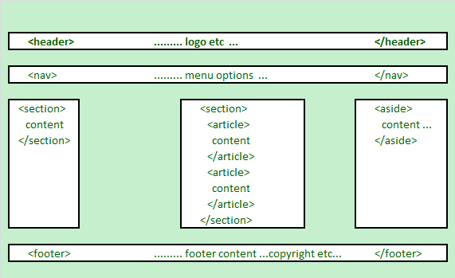
HTML5 Structural Elements
HTML 5 defines a number of new container elements for constructing documents.
header, nav, section, aside, article and footer

Slide 35
HTML5 Structural Elements
Elements | Description
<header> | the web page/site header content
<nav> | the navigation functionality for the page/site.
<section> | the grouping of related subjects on the web page.
<main> | the main content on the web page.
<article> | contains a standalone content on the web page.
<aside> | used for content that's not central to the web page.
<footer> | the web page/site footer content
Notes: The <div> element is the generic container for flow content, which does not
inherently represent anything. It should be used only when no other semantic element
(such as above elements) is appropriate.

Slide 36
HTML5 Structural Elements
… …
<body>
<header>......... logo etc … </header>
<nav> ......... menu options … </nav>
<section id="sidebar1">......... section 1 … </section>
<section id="main"><!-- may be replaced by main element -->
<article>article within the section </article>
<article>another article within the section </article>
</section>
<aside>......... aside content … </aside>
<footer> ......... footer content ...copyright etc… </footer>
</body>
</html>
html5_structure.html

Slide 37
HTML5 Structural Elements
The <article> Tags may also contain these elements, e.g.
<article>
<header> … </header>
<section id="introduction">
</section>
<section id="content">
</section>
<section id="summary">
</section>
<footer>…</footer>
</article>

Slide 38
The HTML4 Structural Elements: <div>
… …
<body>
<div class="header">......... logo etc …</div>
<div class="navigation"> ......... menu options … </div>
<div class ="sidebar1">......... Column 1 … </div>
<div class="main">
…………….main column content goes in here………….
</div >
<div class="aside">......... aside content … </div>
<div class="footer"> ......... footer content ...copyright etc… </div>
</body>
</html>

Slide 39
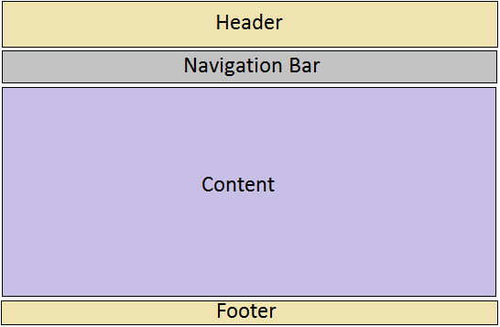
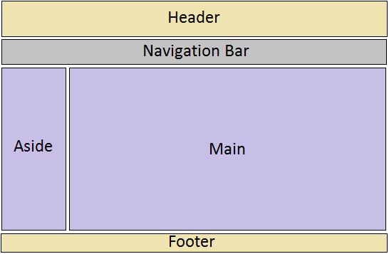
Web Pages Layouts
One-column layout
layout-1-column.html
Two-column layout
layout-2-column.html

Slide 40
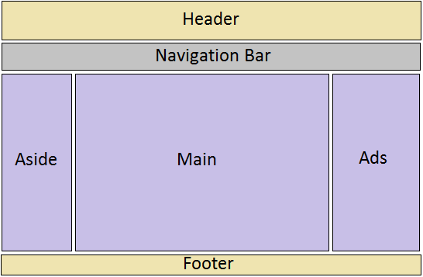
Web Pages Layouts
Three-column layout
layout-3-column.html

Slide 41
Create Layouts with HTML5 and CSS3
Creating 2-column fluid (float-based) layouts with CSS
HTML5 document without CSS:
html5_structure.html
Set the width of the page (e.g. 960px) and center the page:
.container { max-width: 960px; margin: auto; }
Set the width of the “aside” block and float it to left:
aside { width: 192px; float: left; }
Set the width of the “main” section and float it to left:
main { width: 768px; float: left; }

Slide 42
Create Layouts with HTML5 and CSS3
Set the clear property of the footer to ‘both’:
footer { clear: both; background-color: #aaa; }
Set margin, border, padding, background-color, … to each structural element, e.g.:
aside, main {margin-top: 58px; margin-right: 10px; margin-left: 10px; }
Note: You may use relative width values (e.g. 80%) for the page and columns.

Slide 43
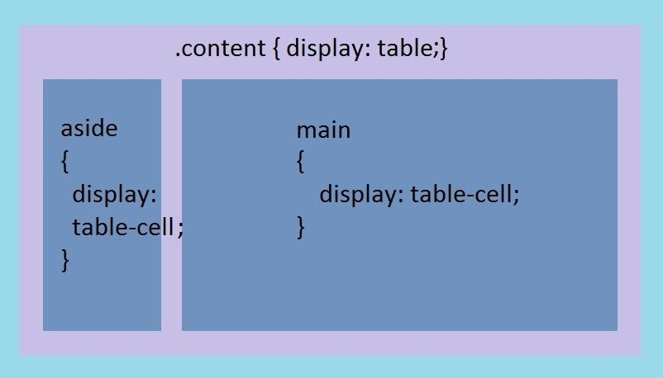
Create Layouts with HTML5 and CSS3
Creating 2-column tabular layouts with CSS
HTML5 document without CSS:
html5_structure.html
Set CSS:

Slide 44
Create Layouts with HTML5 and CSS3
Creating 2-column tabular layouts with CSS (cont’)
CSS code for 2-column tabular layouts :
.container { display: table; width: 960px; margin: auto; }
aside { display: table-cell; width: 192px; }
main { display: table-cell; width: 720px; }
footer { background-color: #aaa; }
aside, main {margin-top: 58px; margin-right: 10px; margin-left: 10px;
Note: using HTML table to create page layouts is obsolete and not allowed in WEB222 assignments

Slide 45
Navigation and Menus
Web page navigation: list of links
<nav>
<ul>
<li><a href="#top">Home</a></li>
<li><a href="#timetable">Timetable</a></li>
<li><a href="#standards">Standards</a></li>
<li><a href="ibc233/ibc233.html">IBC233</a></li>
<li><a href="int222/web222.html">WEB222</a></li>
<li><a href="bti220/bti220.html">BTI220</a></li>
</ul>
</nav>
Using CSS to convert the unordered the list to a navigation bar or menu.
Usually, navigation/menus one each page of a website should be identical.

Slide 46
Navigation and Menus
Single Level Menu Options
Horizontal Single Level Menu Example
Navigation bar
Vertical Single Level Menu Example
Multi Level Menu Options
Horizontal Multi Level Menu Example
Dropdown menu
Vertical Multi Level Menu Example

Slide 47
Flexbox
Flexbox is the short name for the Flexible Box Layout CSS module, designed to make it easy for us to lay things out in one dimension — either as a row or as a column.
To use flexbox, you apply display: flex to the parent element of the elements you want to lay out
.wrapper {
display: flex;
flex-direction:column;
align-items: stretch;
}
They are displayed in a row because the property flex-direction of the parent element has an initial value of row
They are displayed in a row because the property flex-direction of the parent element has an initial value of row
Flex-example1.html flex-example2.html

Slide 48
Flexbox: Setting flex property
we can add the flex property to all of our child items, and give it a value of 1. This will cause all of the items to grow and fill the container, rather than leaving space at the end.
If there is more space then the items will become wider; if there is less space they will become narrower.
If you add another element to the markup, the other items will all become smaller to make space for it; the items all together continue taking up all the space.
Flex-example3.html

Slide 49
Grid Layout
Grid Layout is designed for two dimensions — lining things up in rows and columns.
we enable Grid Layout with its specific display value — display: grid.
In addition to using display: grid, we also define some row and column tracks for the parent using the grid-template-rows and grid-template-columns properties respectively.
grid-example1.html

Slide 50
Placing items on the grid
Once you have a grid, you can explicitly place your items on it, rather than relying on the auto-placement behavior.
You can set the start and end line of each item using the grid-column and grid-row properties. This causes the items to span multiple tracks.
grid-example2.html

Slide 51
Creating a simple website
Create a plan
How many web pages? What are the file names for these pages?
Website directory structure?
e.g. Create “css” sub-folder for storing CSS files; create “images” sub-folder for image files
Create a template HTML document: template.html
HTML: links to external CSS file(s) and JavaScript file(s).
Design and code nav menu, footer, and/or theme/basic page layout.
Menu: items link to corresponding planed web pages.
Copy and name template.html to all planned web pages
Nav menu, footer, theme of all pages should be the same.
Create page layout for each page.
index.html – the default home page shown on a website if no file name is specified.

Slide 52
Creating a simple website
Create a plan
How many web pages? What are the file names for these pages?
Website directory structure?
e.g. Create “css” sub-folder for storing CSS files; create “images” sub-folder for image files
Create a template HTML document: template.html
HTML: links to external CSS file(s) and JavaScript file(s).
Design and code nav menu, footer, and/or theme/basic page layout.
Menu: items link to corresponding planed web pages.
Copy and name template.html to all planned web pages
Nav menu, footer, theme of all pages should be the same.
Create page layout for each page.
index.html – the default home page shown on a website if no file name is specified.

Slide 53
Image Gallery Example
CSS can be used to create an image gallery.
Wrapping up images
In image gallery, an image may have a caption, description, or an action, which is performed when the image is clicked and JavaScript may be used.
Examples of wrapping up images
Example 1:
<div class="image">
<a target="_blank" href="images/travel-1.jpg">
<img src="images/travel-1.jpg" alt="Travel">
</a>
<div class="desc">Travel</div>
</div>

Slide 54
Image Gallery Example
Example 2:
<figure>
<img src='images/tnnatgeo201201.jpg' alt=' ' onclick='imageView("images/natgeo201201.jpg");'>
<figcaption>The Matterhorn: Night Clouds #2 -- The Matterhorn, 4478 m, at full moon. (&copy; Nenad Saljic/National Geographic Photo Contest)</figcaption>
</figure>

Slide 55
Image Gallery Example
Setting up CSS for image boxes, e.g.
figure {
float: left; // for grid galleries
height: 175px; // size of image boxes
margin: 1em 2em 0 0;
}
Setting up CSS for images, e.g.
figure img {
padding: 10px;
border: 1px solid black;
border-radius: 5px;
margin: 10px;
cursor: pointer;
}

Slide 56
Image Gallery Example
Setting up CSS for captions, descriptions, e.g.
figure figcaption {
width: 200px;
font-size: 0.7em;
padding: 5px;
margin-left: -1000em;
margin-top: -20px;
background-color: #ffa;
border: 1px solid #ffad33;
border-radius: 5px;
position: absolute;
}

Slide 57
Image Gallery Example
Adding two more div elements on the page for showing up full-size images.
<div id="popup">
<!-- large version of the image -->
<img class="image" id="popupImage" alt="Loading..."
src="nothing.jpg" />
<div class="close" onclick="imageClose();">
&nbsp;X&nbsp;
</div>
</div>
<div id="popupbg"></div>
grid-gallery.html

Slide 58
Image Gallery Example
JavaScript for showing up full-size images
function imageView(bigImage) {
// on the full-size image, set the 'src' attribute that's passed in the '#popupImage' element is an img
document.querySelector('#popupImage').setAttribute('src', bigImage);
// show the full-size image. // the '#popup' element is a div
document.querySelector('#popup').style.display = 'block';
// show the faded background image. // the '#popupbg' element is a div
document.querySelector('#popupbg').style.visibility = 'visible';
}
JS for closing full-size images
function imageClose() {
// hide the full-size image
document.querySelector('#popup').style.display = 'none';
// hide the faded background image
document.querySelector('#popupbg').style.visibility = 'hidden';
}

Slide 59
Resourceful Links
CSS Library
CSS Reference
http://reference.sitepoint.com/css
Box model - CSS | MDN
https://developer.mozilla.org/en-US/docs/Web/CSS/box_model
CSS Properties
http://reference.sitepoint.com/css/propertyref
CSS Selectors
http://reference.sitepoint.com/css/selectorref
Bootstrap's Responsive Grid and Navbar

Slide 60
Thank You!

